Slide 1

RE 2017
September 4-8, 2017
Lisbon, Portugal

Slide 2


Brief History of the Conference

Slide 3
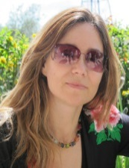
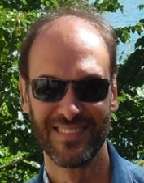
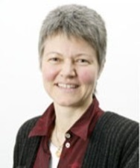
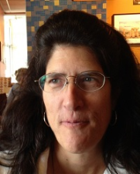
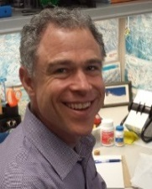
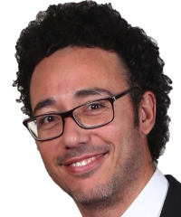
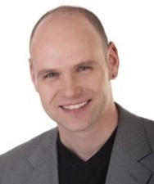
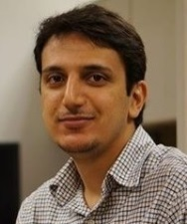
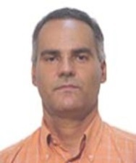
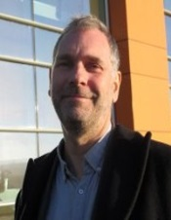
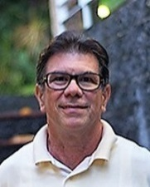
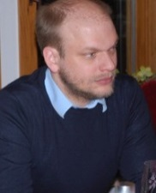
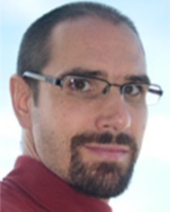
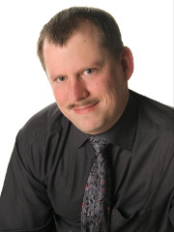
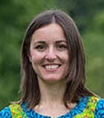
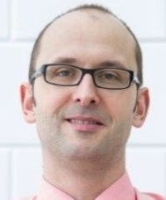
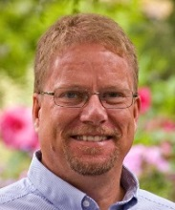
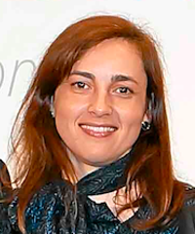
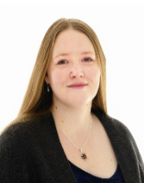
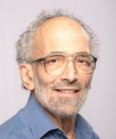
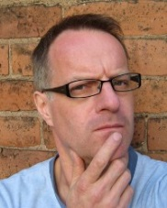
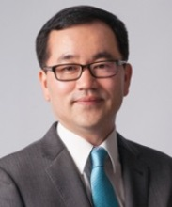
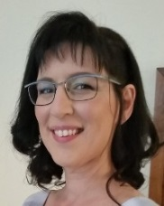
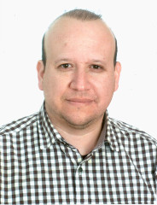
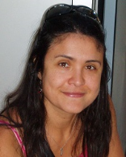
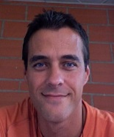
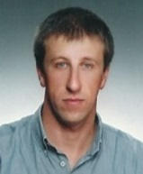
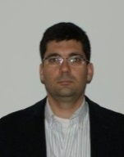
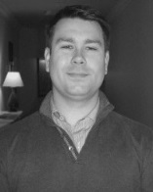
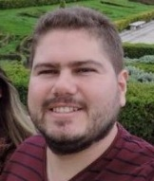
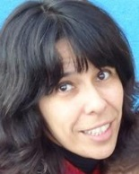
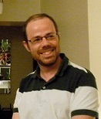

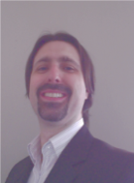
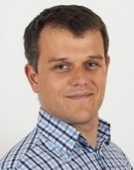
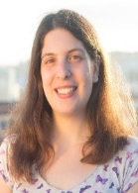
Organizing Committee
Beginning from top left: Ana Moreira, João Araújo, Barbara Paech, Jane Hayes, Michael C. Panis, Walid Maalej, Eric Knauss, Mehdi Mirakhorli, Jaelson Castro, Pete Sawyer, Julio Cesar Leite, Richard Berntsson Svensson, Gunter Mussbacher, Frank Houdek, Liliana Pasquale, Joerg Doerr, Mats Heimdahl, Silvia Abrahão, Jennifer Horkoff, Daniel M. Berry, Alistair Mavin, Seok-Won Lee, Irit Hadar, Emilio Insfran, Nelly Bencomo, Jean-Michel Bruel, Ademar Aguiar, Vasco Amaral, Jácome Cunha, Eric de Souza, Isabel Sofia Brito, Miguel Goulão, Yong Xia, Cristiano de Faveri, Krzysztof Wnuk and Catarina Gralha

Slide 4
RE 2017 Theme
"Desperately Seeking Less": The Role of Simplicity and Complementarity in Requirements

Slide 5
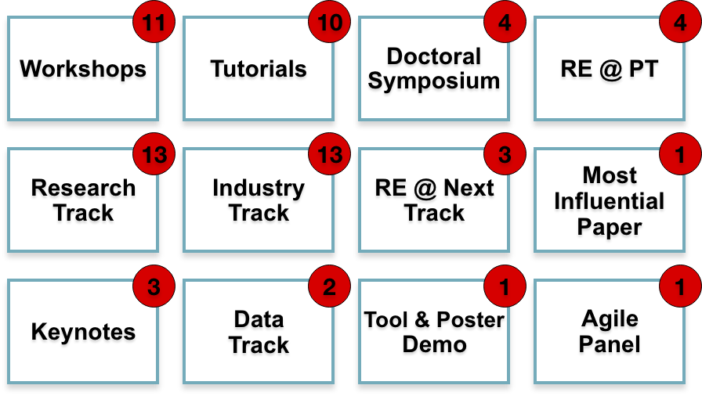
Conference at a Glance

Slide 6
Research Track
96 abstracts proposed
All papers were discussed in person (3 members of the track’s PC) during a meeting in Lexington, KY, USA
Each paper with at least one positive review was subjected to discussion at the PC meeting
In total: 27 papers accepted

Slide 7
Industry Track
30 abstracts proposed
Each paper was reviewed by two members of the track’s PC
Online discussion
11 papers accepted

Slide 8
Data Track
8 abstracts proposed
Each paper was reviewed by two members of the track’s PC
Online discussion
5 papers accepted

Slide 9
RE @ Next
45 abstracts proposed
Each paper was reviewed by three members of the track’s PC
Online discussion
11 papers accepted

Slide 10
Silver Jubilee
12 abstracts proposed
Each paper was reviewed by four members of the track’s PC
Online discussion
5 papers accepted

Slide 11
Submitted Contributions

Slide 12
Accepted Contributions

Slide 13

Author Demographic
255
163
51
10
9
488 authors from 42 different countries

Slide 14
Workshops
International Model-Driven Requirements Engineering Workshop (MoDRE)
International Workshop on Requirements Engineering for Sustainable Systems (RE4SuSy)
Workshop on Evolving Security and Privacy Requirements Engineering (ESPRE)
International Workshop on Usability and Accessibility focused Requirements Engineering (UsARE)
International Workshop on Crowd-Based Requirements Engineering (CrowdRE)
International Workshop on Requirements Engineering and Law (RELAW)

Slide 15
Workshops Continued
International Workshop on Requirements Patterns (RePa)
Workshop on Empirical Requirements Engineering (EmpiRE)
International Workshop on Requirements Engineering and Testing (RET)
International Workshop on Artificial Intelligence for Requirements (AIRE)
International Workshop on Just-In-Time Requirements Engineering: Dealing with Non-Functional Requirements in Agile Software Development (JIT RE)

Slide 16
Tutorials
User Story Best Practices: Requirements in Agile Context
Writing requirements documents with goals: the KAOS/Objectiver approach
Agile Business Rule Development
Writing Good Requirements
Blockchain Requirements Engineering: Research Challenges and Opportunities
From Mining to Planning – Next Generation of Release Decision Making for Software Products
Software Reuse and Reusability based on Requirements: Product Lines, Cases and Feature-Similarity Models
Risk Assessment using Early Requirements Models: A Guided Tour
Evaluating Evolving Requirements Models with URN: Features, Goals, and Scenarios
Eliciting Unstated Requirements

Slide 17
Doctorial Symposium
8 Students Presenting Their Work
Olawole Oni
Ana Isabella Muniz Leite
Mustafa Berk Duran
Jacek Dąbrowski
Rainara Carvalho
Ana M. M. Moura
Jennifer Brings
Rodrigo Falcão

Slide 18
Posters & Demos
10 presentations
Wednesday 2:00 – 3:30 PM

Slide 19
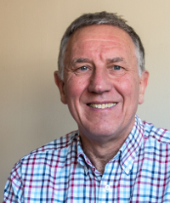
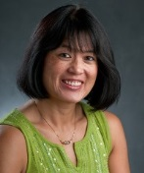

Keynote Speakers
Ian Sommerville (University of St. Andrews) Retired
“Simplicity Considered Harmful (sometimes)”
Friday September 8th
Betty Cheng (Michigan State University)
“Requirements Engineering for High Assurance Autonomous Systems in the Face of Uncertainty: A Multidisciplinary Perspective” Wednesday September 6th
Romana Oehmig (Lead Design Thinking and Business Model Innovation) SAP
“How Design Thinking Works @SAP”
Thursday September 7th

Slide 20
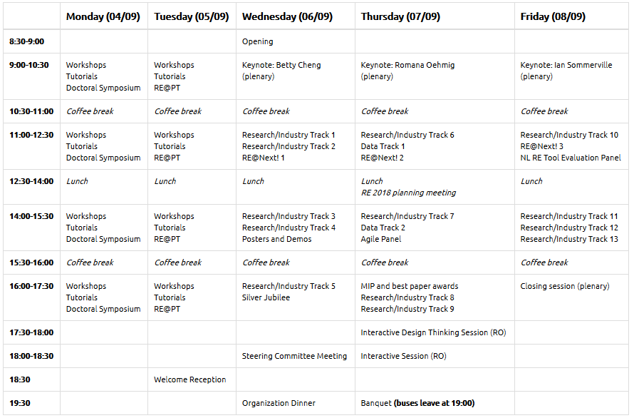
Check Program for Details

Slide 21
Diagram?

Slide 22
Social Events
Welcome Reception: September 5th 2017
Location: Rectorate of Universidade Nova de Lisboa
Banquet: September 7th 2017
Location: Palácio de Xabregas

Slide 23















Donors & Sponsors

Slide 24
RE 2017
Wishing You a Nice Journey During.....

Slide 25

Thank You!
Thank you for ATTENDING
Thank you for SUBMITTING PAPERS
Thank you to all review committee chairs and members, who supported and made this program possible
Thank you to the organizing committee who made this program happen
LETS ENJOY THE CONFERENCE!

